Slide 1
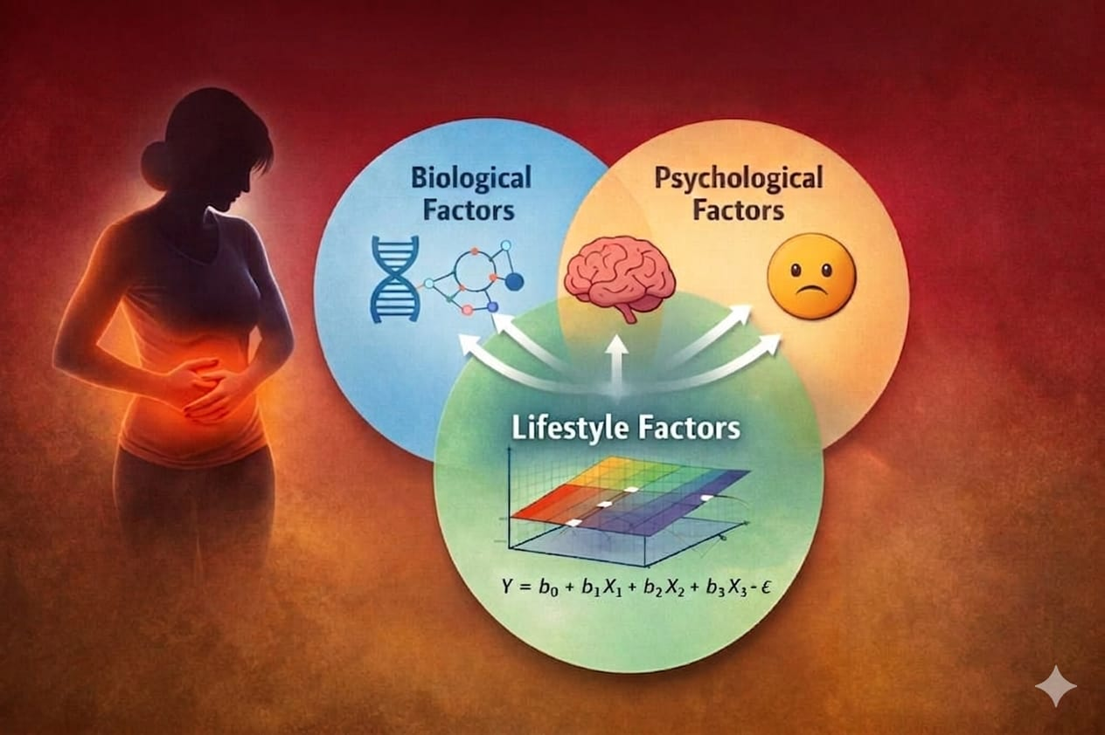
Regression Analysis on Menstrual Pain
A comprehensive statistical modeling approach to understanding pain predictors using
biological, psychological, lifestyle, and demographic factors

Slide 2
INTRODUCTION
Menstrual pain (dysmenorrhea) is a common health concern that varies across individuals due to biological, psychological, lifestyle, and health-related factors. Understanding these influences is important for improving health outcomes and awareness. This study employs regression techniques to systematically analyze how various factors contribute to variations in pain levels, enabling a deeper and more evidence-based understanding of menstrual health.
Understanding these determinants is essential for improving health outcomes, guiding interventions, and promoting awareness. With the increasing availability of data-driven tools, statistical modeling—particularly regression analysis—provides an effective framework to quantify the impact of multiple predictors on menstrual pain levels.

Slide 3
BACKGROUND OF THE STUDY
Menstrual health is an important health issue affecting women’s physical and emotional well-being, often impacting daily activities and quality of life. Previous studies have identified biological and lifestyle factors such as hormonal imbalance, diet, stress, and physical activity as key determinants of menstrual pain. However, most research examines these factors individually rather than considering their combined effects. Psychological factors such as stress , mood also plays an important role.
Therefore, this study aims to analyze the combined impact of biological, psychological and lifestyle factors on menstrual pain using a comprehensive approach.

Slide 4
DATA SOURCE
The data is sourced from KAGGLE. The link is attached
https://www.kaggle.com/datasets/puspitachowdhury2/menstrual-health-dataset
This dataset was taken to study how menstrual cycle patterns interact with lifestyle habits, stress, sleep quality, and overall health. It contains two linked files:
Period_Log.csv (Cycle-Level Data)
User_Profile.csv (User-Level Data)
VARIABLE CATEGORY | VARIABLES INCLUDED
Cycle Information | Cycle number, Start date, Cycle length
Menstrual Details | Flow intensity, Pain level (0–10), PMS symptoms (Yes/No)
Emotional & Physical | Mood score, Energy score, Stress score
Lifestyle Factors | Sleep duration, Water intake, Caffeine intake
Productivity | Concentration level, Productivity loss
VARIABLE CATEGORY | VARIABLES INCLUDED
Demographics | Age, BMI, State of residence
Health Status | General health rating, PCOS diagnosis
Lifestyle Factors | Exercise frequency, Sleep hours
Behavioral Factors | Smoking, Alcohol consumption
Reproductive Health | Birth control status
Psychological Factor | Baseline stress score

Slide 5
Dataset Overview
Feature | Description
Number of Users | 2000 females
Data Structure | One-to-many (one user → multiple cycle logs)
Purpose | To analyze menstrual health trends, predict pain/PMS, and study impact on productivity
Minimum cycles per user: 6
Maximum cycles per user: 12
So, most users have around 6–12 cycles recorded.
Number of regressors = 32

Slide 6
RESEARCH OBJECTIVE
The primary objective of this study is
To analyze the impact between biological, psychological, lifestyle, and health-related factors and menstrual pain intensity.
It aims to identify the key determinants influencing menstrual health and to evaluate the combined effect of these factors using statistical modeling techniques.
To provide insights that can support awareness, healthcare strategies, and future research in menstrual health.

Slide 7
RESEARCH HYPOTHESIS
Null Hypothesis (H₀):
None of the independent variables significantly affect menstrual pain level. (All regression coefficients = 0)
Alternative Hypothesis (H₁):
At least one independent variable significantly affects menstrual pain level. (At least one regression coefficient ≠ 0)

Slide 8
RESEARCH METHODOLOGY
Data collection
↓
Data Preparation
↓
Multicollinearity Check
(VIF, Correlation Matrix)
↓
Hierarchical Linear Model (HLM)
(Multi-level Modeling: User & Cycle Level)
↓
Diagnostic Check
(Residual Analysis, Normality, Homoscedasticity)
↓
LASSO Regression with K-Fold Cross Validation
(Model Selection & Regularization)
↓
Final Model Interpretation & Results
↓
Conclusion

Slide 9
Multicollinearity
Multicollinearity refers to a situation in regression analysis where two or more independent variables are highly correlated with each other. This means they contain similar information about the variance in the dependent variable.
A multicollinearity check is the process of detecting this issue using tools like:
Correlation Matrix
Eigen System Analysis
Variance Inflation Factor (VIF)

Slide 10
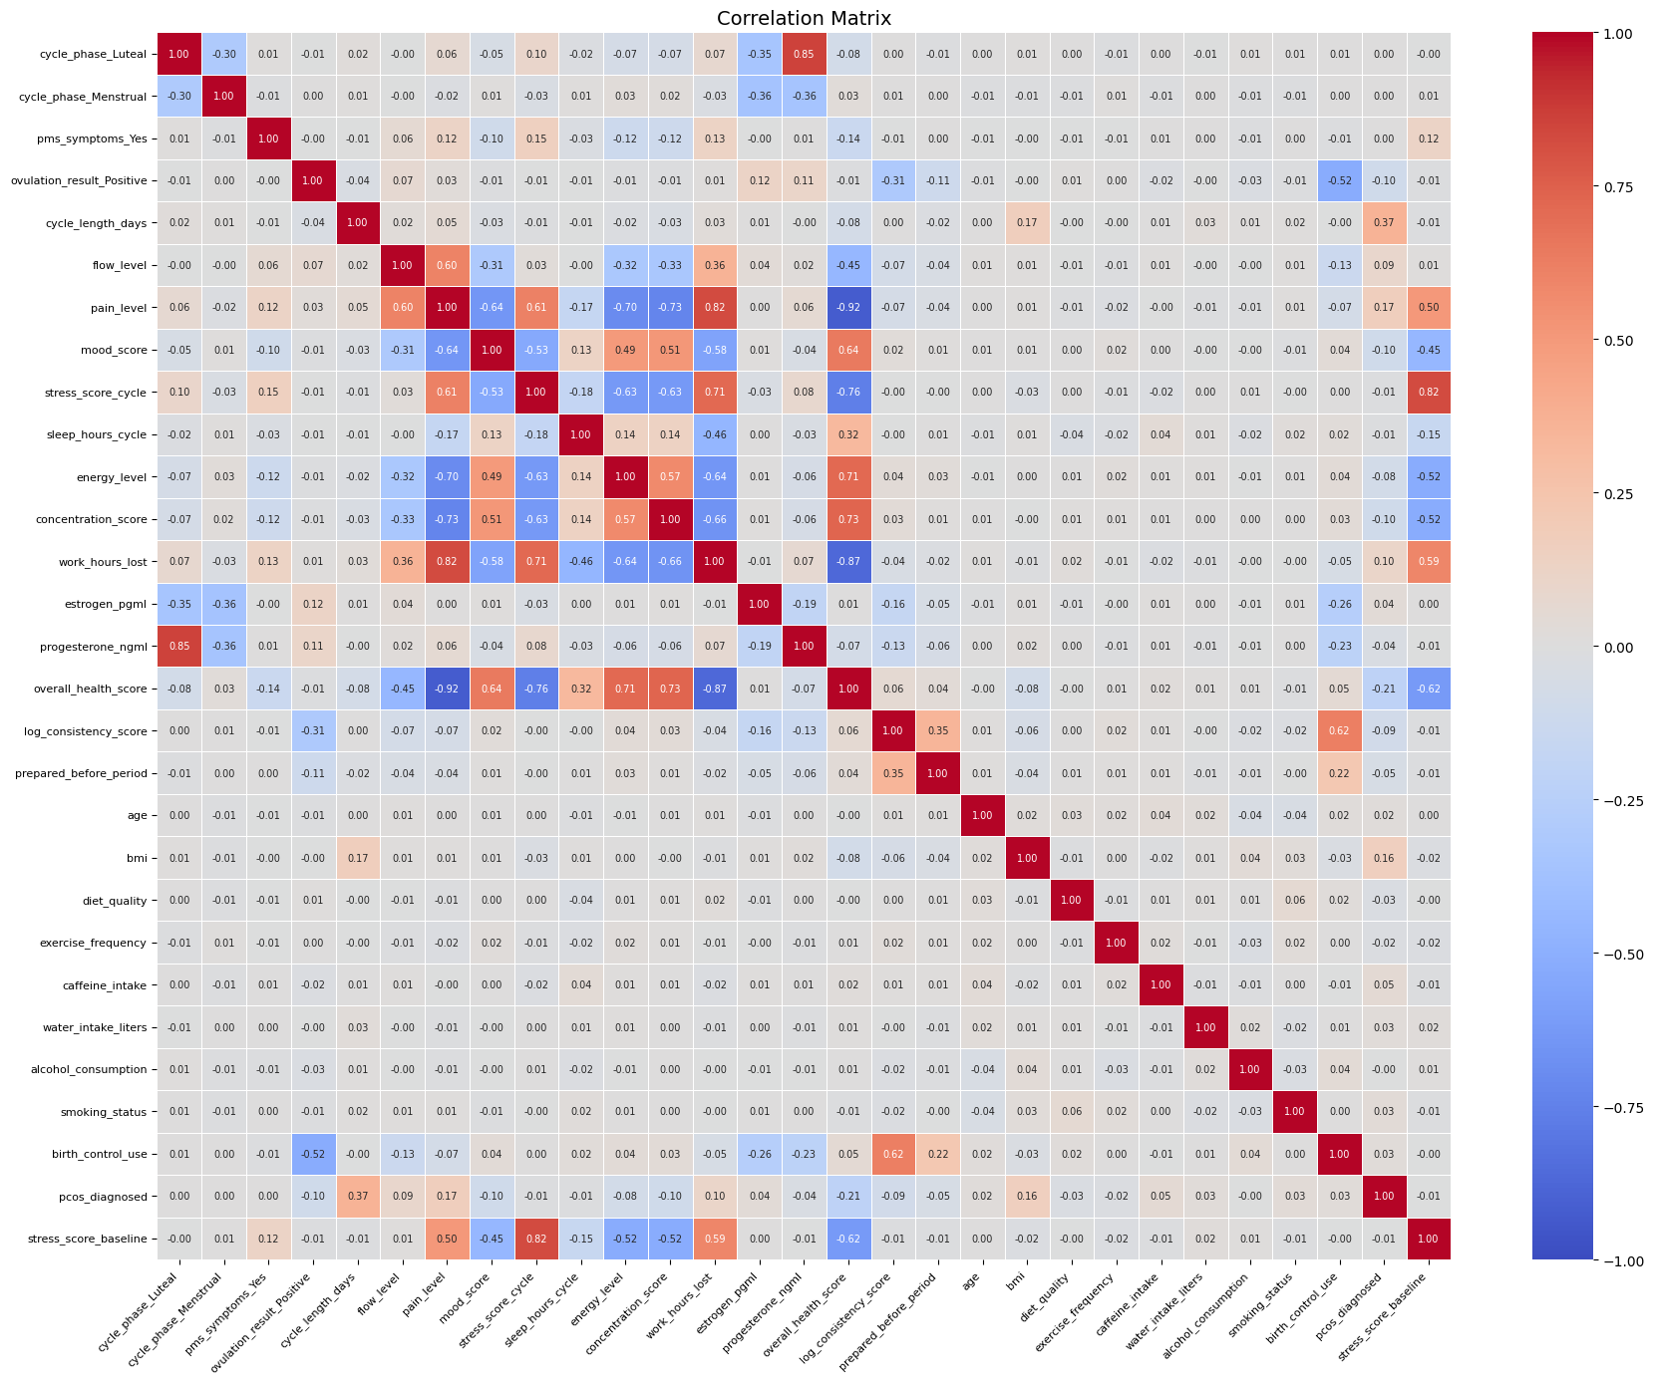
CORRELATION HEATMAP
The correlation matrix shows that pain and stress negatively impact overall health, energy, concentration, and productivity.
Positive factors such as higher energy, better concentration, and good mood are strongly associated with better health outcomes.
Overall, well-being is mainly driven by symptom severity and mental state, while lifestyle factors show weaker direct effects.

Slide 11
EIGEN SYSTEM ANALYSIS
METRIC | VALUE | INTERPRETATION
Minimum Eigenvalue | 0.075 | Small but not extremely close to 0
Maximum Eigenvalue | 5.077 | Moderate spread
Condition Number (K) | 67.27 | Moderate to High Multicollinearity
Number of Variables | 28 | High dimensional model
The condition number (67.27) indicates moderate to high multicollinearity, but it is NOT severe.
No extremely small eigenvalues (≈ 0), so no perfect multicollinearity.
Condition indices are mostly below 10, indicating:
No critical instability
Only mild linear dependencies
The eigen system analysis indicates moderate multicollinearity, but the model remains stable and suitable for interpretation.

Slide 12
Variance Inflation Factor
VARIABLE | VIF
overall_health_score | 9.370
stress_score_cycle | 6.737
work_hours_lost | 5.390
progesterone_ngml | 4.812
cycle_phase_Luteal | 4.800
stress_score_baseline | 3.211
birth_control_use | 2.448
concentration_score | 2.311
energy_level | 2.188
flow_level | 2.106
log_consistency_score | 1.800
mood_score | 1.763
estrogen_pgml | 1.750
cycle_phase_Menstrual | 1.620
sleep_hours_cycle | 1.592
pcos_diagnosed | 1.411
ovulation_result_Positive | 1.382
cycle_length_days | 1.179
prepared_before_period | 1.141
bmi | 1.094
pms_symptoms_Yes | 1.029
alcohol_consumption | 1.014
smoking_status | 1.011
age | 1.011
diet_quality | 1.010
caffeine_intake | 1.009
exercise_frequency | 1.006
water_intake_liters | 1.005
Most variables show low multicollinearity, with VIF values close to 1–3, indicating stable and reliable estimates.
A few variables have moderately high VIF (>5), suggesting some multicollinearity that may need attention.
No severe multicollinearity detected (VIF < 10 for all variables), so the model is generally acceptable without major corrections.

Slide 13
VARIABLE | VIF
log_consistency_score | 628.353
sleep_hours_cycle | 175.782
cycle_length_days | 166.905
prev_cycle_length | 166.520
stress_score_cycle | 64.560
concentration_score | 58.784
stress_score_baseline | 49.051
mood_score | 38.692
energy_level | 36.116
bmi | 32.349
age | 28.771
work_hours_lost | 27.253
estrogen_pgml | 22.580
progesterone_ngml | 14.326
water_intake_liters | 12.122
cycle_phase_Luteal | 8.691
diet_quality | 4.883
caffeine_intake | 3.958
flow_level | 3.886
birth_control_use | 3.147
prepared_before_period | 3.014
ovulation_result_Positive | 2.975
exercise_frequency | 2.302
alcohol_consumption | 1.945
cycle_phase_Menstrual | 1.799
pcos_diagnosed | 1.489
pms_symptoms_Yes | 1.460
smoking_status | 1.130
VIF (AFTER REMOVING
overall_health_score)
Removing overall_health_score worsened multicollinearity.
Several variables now show extremely high VIFs (>50, even >100), indicating severe multicollinearity and unstable estimates.
This suggests overall_health_score was absorbing shared variance, and its removal exposed strong underlying correlations among predictors.

Slide 14
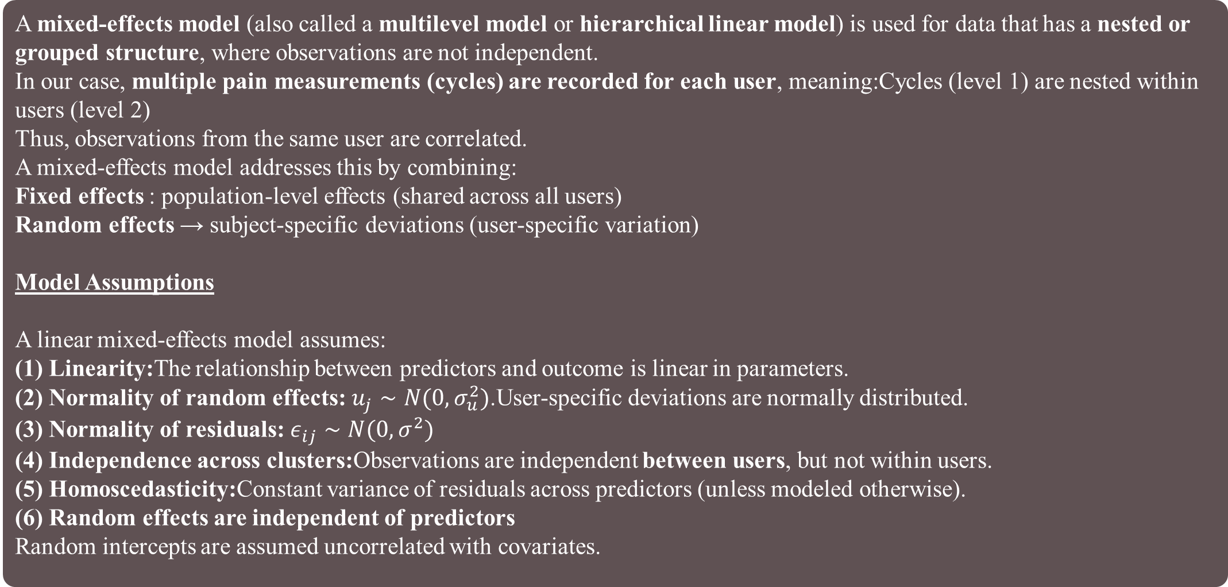
MIXED EFFECT MODEL
A mixed-effects model (also called a multilevel model or hierarchical linear model) is used for data that has a nested or grouped structure, where observations are not independent.
In our case, multiple pain measurements (cycles) are recorded for each user, meaning:Cycles (level 1) are nested within users (level 2)
Thus, observations from the same user are correlated.
A mixed-effects model addresses this by combining:
Fixed effects : population-level effects (shared across all users)
Random effects → subject-specific deviations (user-specific variation)
Model Assumptions
A linear mixed-effects model assumes:
(1) Linearity:The relationship between predictors and outcome is linear in parameters.
(2) Normality of random effects:$u_{j}∼N(0,σ_{u}^{2})$.User-specific deviations are normally distributed.
(3) Normality of residuals:$ε_{ij}∼N(0,σ^{2})$
(4) Independence across clusters:Observations are independent between users, but not within users.
(5) Homoscedasticity:Constant variance of residuals across predictors (unless modeled otherwise).
(6) Random effects are independent of predictors
Random intercepts are assumed uncorrelated with covariates.

Slide 15
WHY MIXED EFFECT MODEL IS APPROPRIATE FOR OUR DATa
Our dataset has:
Level 1 (Within-user / cycle-level variation):
Variables that change across cycles for the same user:
cycle_length_days
cycle_phase
flow_level
pms_symptoms
mood_score
stress_score_cycle
sleep_hours_cycle
energy_level
concentration_score
work_hours_lost
estrogen_pgml
progesterone_ngml
ovulation_result
overall_health_score
log_consistency_score
prepared_before_period
cycle_number
Level 2 (Between-user variation):
Variables that are constant for each user:
age
bmi
diet_quality
exercise_frequency
caffeine_intake
water_intake_liters
alcohol_consumption
smoking_status
birth_control_use
pcos_diagnosed
stress_score_baseline
Since cycle observations are repeated within users, independence is violated, making mixed modeling necessary.

Slide 16
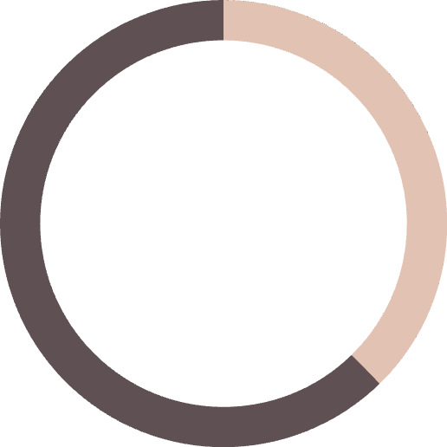
Model 1: Biological Variables Only
The model converged successfully, so estimates are reliable.
Statistically Significant Variables (p < 0.05)
• Cycle Phase (Luteal) • Flow Level • PMS Symptoms
Not Statistically Significant Variables (p > 0.05):
These variables do not show strong evidence of impact on pain:
• Cycle Length Days •Menstrual Phase
• Estrogen Level • Progesterone Level
• Ovulation result(positive)
48.5%
48.5%
Marginal R²
Adjusted R²
69.5%
The model explains about 48.5% of the variation in pain levels through fixed effects (Marginal R² ≈ Adjusted R²), indicating a stable and well-specified model. When accounting for both fixed and group-level random effects, the explained variation increases to 69.5% (Conditional R²), highlighting the importance of individual differences.
Conditional R²

Slide 17
Variable | Coefficient | Std. Error | z-value | p-value | 95% CI (Lower) | 95% CI (Upper)
Intercept | 20.742 | 0.543 | 38.233 | 0.000 | 19.678 | 21.805
cycle_length_days | -0.008 | 0.002 | -3.909 | 0.000 | -0.012 | -0.004
cycle_phase_Luteal | -0.029 | 0.019 | -1.527 | 0.127 | -0.066 | 0.008
cycle_phase_Menstrual | -0.006 | 0.018 | -0.328 | 0.743 | -0.041 | 0.029
flow_level | 0.292 | 0.010 | 29.873 | 0.000 | 0.273 | 0.311
pms_symptoms_Yes | -0.017 | 0.010 | -1.809 | 0.070 | -0.036 | 0.001
estrogen_pgml | -0.000 | 0.000 | -0.119 | 0.906 | -0.000 | 0.000
progesterone_ngml | 0.003 | 0.002 | 1.382 | 0.167 | -0.001 | 0.008
ovulation_result_Positive | 0.019 | 0.010 | 1.927 | 0.054 | -0.000 | 0.038
mood_score | -0.057 | 0.004 | -14.984 | 0.000 | -0.064 | -0.049
stress_score_cycle | -0.372 | 0.006 | -57.437 | 0.000 | -0.385 | -0.359
stress_score_baseline | 0.005 | 0.009 | 0.598 | 0.550 | -0.012 | 0.022
energy_level | -0.059 | 0.004 | -15.703 | 0.000 | -0.067 | -0.052

Slide 18
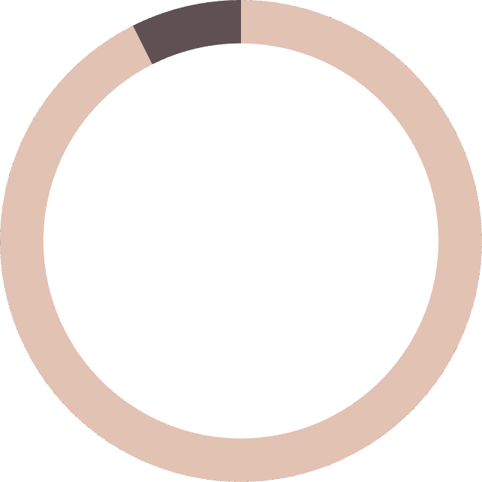
Model 2: BIOLOGICAL + Psychological VARIABLEs
The model converged successfully, so estimates are reliable.
Statistically Significant Variables (p < 0.05)
Variables that Increase Pain Level
• Flow Level
Variables that Decrease Pain Level
• Cycle Length Days •Mood score • Stress score level •Energy Level • Concentration Score • Overall health Score
Not Statistically Significant Variables (p > 0.05):
These variables do not show strong evidence of impact on pain:
• cycle phase Luteal • cycle phase Menstrual • pms symptoms • estrogen pgml • progesterone ngml
• ovulation result Positive • stress score baseline
• prepared before period
89.9%
89.9%
Marginal R²
Adjusted R²
95.4%
The model explains about 89.9% of the variation in pain level through fixed predictors alone (Marginal R²), and 95.4% when individual/group-level random effects are also included (Conditional R²).
Conditional R²

Slide 19
Variable | Coef. | Std.Err. | z | P>|z| | 95% CI Lower | 95% CI Upper
Intercept | 25.871 | 0.152 | 170.066 | 0.000 | 25.573 | 26.170
cycle_length_days | -0.006 | 0.002 | -2.712 | 0.007 | -0.010 | -0.002
cycle_phase_Luteal | -0.027 | 0.020 | -1.357 | 0.175 | -0.066 | 0.012
cycle_phase_Menstrual | -0.010 | 0.019 | -0.522 | 0.601 | -0.047 | 0.027
flow_level | 0.363 | 0.010 | 36.774 | 0.000 | 0.344 | 0.383
pms_symptoms_Yes | -0.018 | 0.010 | -1.779 | 0.075 | -0.038 | 0.002
estrogen_pgml | -0.000 | 0.000 | -0.191 | 0.849 | -0.000 | 0.000
progesterone_ngml | 0.003 | 0.003 | 0.992 | 0.321 | -0.003 | 0.008
ovulation_result_Positive | 0.013 | 0.011 | 1.191 | 0.234 | -0.008 | 0.033
mood_score | -0.063 | 0.004 | -15.556 | 0.000 | -0.071 | -0.055
stress_score_cycle | -0.335 | 0.007 | -49.130 | 0.000 | -0.348 | -0.321
stress_score_baseline | 0.007 | 0.011 | 0.708 | 0.479 | -0.013 | 0.028
energy_level | -0.069 | 0.004 | -17.163 | 0.000 | -0.077 | -0.061
concentration_score | -0.100 | 0.005 | -20.546 | 0.000 | -0.109 | -0.090
overall_health_score | -2.058 | 0.013 | -164.405 | 0.000 | -2.083 | -2.034
prepared_before_period | 0.008 | 0.010 | 0.821 | 0.412 | -0.011 | 0.028
Group Var | 0.286 | 0.026 | — | — | — | —

Slide 20
Model 3: BIOLOGICAL + Psychological + LIFESTYLE VARIABLEs
The model converged successfully, so estimates are reliable.
Statistically Significant Variables (p < 0.05)
Variables that Increase Pain Level
• Flow Level • Sleep Hours•Sleep Hours Cycle• Work hour lost
Variables that Decrease Pain Level
• Cycle Length Days •Mood score • Stress score level •Energy Level • Concentration Score • Overall health Score
Not Statistically Significant Variables (p > 0.05):
These variables do not show strong evidence of impact on pain:
• cycle phase Luteal • cycle phase Menstrual • pms symptoms • estrogen pgml • progesterone ngml
• ovulation result Positive • stress score baseline
• prepared before period • Diet Quality •Exercise Frequency • Alchohol Consumption •Smoking
92.6%
92.6%
Marginal R²
Adjusted R²
95.9%
Conditional R²
The model explains 92.65% of the variation in pain level through fixed predictors alone (Marginal R²), and 95.86% when group-level random effects are also included (Conditional R²). The Adjusted Marginal R² of 92.63% confirms that this strong explanatory power remains robust even after accounting for the number of predictors in the model.

Slide 21
Variable | Coef. | Std.Err. | z | P>|z| | 95% CI Lower | 95% CI Upper
Intercept | 20.742 | 0.543 | 38.233 | 0.000 | 19.678 | 21.805
cycle_length_days | -0.008 | 0.002 | -3.909 | 0.000 | -0.012 | -0.004
cycle_phase_Luteal | -0.029 | 0.019 | -1.527 | 0.127 | -0.066 | 0.008
cycle_phase_Menstrual | -0.006 | 0.018 | -0.328 | 0.743 | -0.041 | 0.029
flow_level | 0.292 | 0.010 | 29.873 | 0.000 | 0.273 | 0.311
pms_symptoms_Yes | -0.017 | 0.010 | -1.809 | 0.070 | -0.036 | 0.001
estrogen_pgml | -0.000 | 0.000 | -0.119 | 0.906 | -0.000 | 0.000
progesterone_ngml | 0.003 | 0.002 | 1.382 | 0.167 | -0.001 | 0.008
ovulation_result_Positive | 0.019 | 0.010 | 1.927 | 0.054 | -0.000 | 0.038
mood_score | -0.057 | 0.004 | -14.984 | 0.000 | -0.064 | -0.049
stress_score_cycle | -0.372 | 0.006 | -57.437 | 0.000 | -0.385 | -0.359
stress_score_baseline | 0.005 | 0.009 | 0.598 | 0.550 | -0.012 | 0.022
energy_level | -0.059 | 0.004 | -15.703 | 0.000 | -0.067 | -0.052
concentration_score | -0.087 | 0.005 | -18.922 | 0.000 | -0.096 | -0.078
overall_health_score | -1.914 | 0.014 | -132.562 | 0.000 | -1.942 | -1.886
prepared_before_period | 0.006 | 0.009 | 0.599 | 0.549 | -0.013 | 0.024
sleep_hours | 0.136 | 0.012 | 11.531 | 0.000 | 0.113 | 0.160
diet_quality | -0.004 | 0.014 | -0.275 | 0.784 | -0.031 | 0.023
exercise_frequency | -0.017 | 0.015 | -1.089 | 0.276 | -0.047 | 0.013
sleep_hours_cycle | 0.202 | 0.008 | 24.438 | 0.000 | 0.186 | 0.218
caffeine_intake | 0.005 | 0.010 | 0.451 | 0.652 | -0.015 | 0.025
alcohol_consumption | -0.003 | 0.016 | -0.173 | 0.862 | -0.035 | 0.029
smoking_status | -0.020 | 0.036 | -0.558 | 0.577 | -0.091 | 0.050
work_hours_lost | 0.250 | 0.007 | 36.377 | 0.000 | 0.237 | 0.264
log_consistency_score | 0.888 | 0.547 | 1.623 | 0.105 | -0.184 | 1.960
Group Var | 0.163 | 0.017 | — | — | — | —

Slide 22
Model 4: ALL VARIABLEs
The model converged successfully, so estimates are reliable.
Statistically Significant Variables (p < 0.05)
Strong Positive Effects (increase pain level):
• flow level • sleep hours cycle • sleep hours
Strong Negative Effects (reduce pain level)
• mood score • stress score cycle• energy level
• concentration score • overall health score • bmi
• pcos diagnosed
Not Statistically Significant Variables (p > 0.05):
These variables do not show strong evidence of impact on pain:
• Cycle phase (Luteal, Menstrual) • PMS symptoms
• Ovulation result •Hormones (estrogen, progesterone)
• Age •Diet quality •Exercise frequency •Caffeine •water intake •Alcohol consumption •Smoking status
• Birth control use •Baseline stress •Cycle number
• Log consistency
92.5%
95.5%
Marginal R²
Conditional R²
92.5%
Adjusted R²
Marginal R² (~0.925) and Adjusted Marginal R² (~0.925) show that about 92.5% of the variation in pain_level is explained by the predictors. Conditional R² (~0.955) indicates that including group-level (random) effects increases explained variance to 95.5%.

Slide 23
Variable | Coefficient | Std. Error | z-value | p-value | 95% CI (Lower) | 95% CI (Upper)
Intercept | 20.742 | 0.543 | 38.233 | 0.000 | 19.678 | 21.805
cycle_length_days | -0.008 | 0.002 | -3.909 | 0.000 | -0.012 | -0.004
cycle_phase_Luteal | -0.029 | 0.019 | -1.527 | 0.127 | -0.066 | 0.008
cycle_phase_Menstrual | -0.006 | 0.018 | -0.328 | 0.743 | -0.041 | 0.029
flow_level | 0.292 | 0.010 | 29.873 | 0.000 | 0.273 | 0.311
pms_symptoms_Yes | -0.017 | 0.010 | -1.809 | 0.070 | -0.036 | 0.001
estrogen_pgml | -0.000 | 0.000 | -0.119 | 0.906 | -0.000 | 0.000
progesterone_ngml | 0.003 | 0.002 | 1.382 | 0.167 | -0.001 | 0.008
ovulation_result_Positive | 0.019 | 0.010 | 1.927 | 0.054 | -0.000 | 0.038
mood_score | -0.057 | 0.004 | -14.984 | 0.000 | -0.064 | -0.049
stress_score_cycle | -0.372 | 0.006 | -57.437 | 0.000 | -0.385 | -0.359
stress_score_baseline | 0.005 | 0.009 | 0.598 | 0.550 | -0.012 | 0.022
energy_level | -0.059 | 0.004 | -15.703 | 0.000 | -0.067 | -0.052
concentration_score | -0.087 | 0.005 | -18.922 | 0.000 | -0.096 | -0.078
overall_health_score | -1.914 | 0.014 | -132.562 | 0.000 | -1.942 | -1.886
prepared_before_period | 0.006 | 0.009 | 0.599 | 0.549 | -0.013 | 0.024
sleep_hours | 0.136 | 0.012 | 11.531 | 0.000 | 0.113 | 0.160
diet_quality | -0.004 | 0.014 | -0.275 | 0.784 | -0.031 | 0.023
exercise_frequency | -0.017 | 0.015 | -1.089 | 0.276 | -0.047 | 0.013
sleep_hours_cycle | 0.202 | 0.008 | 24.438 | 0.000 | 0.186 | 0.218
caffeine_intake | 0.005 | 0.010 | 0.451 | 0.652 | -0.015 | 0.025
alcohol_consumption | -0.003 | 0.016 | -0.173 | 0.862_

Slide 24
SUMMARY TABLE
Metric | Model 1 (Basic) | Model 2 (Extended) | Model 3 (Full Model) | Model 4 (Enhanced)
Marginal R² (Fixed Effects) | 0.4847 | 0.8994 | 0.9265 (Best) | 0.9250
Conditional R² (Total) | 0.6947 | 0.9545 | 0.9586 (Best) | 0.9550
Adjusted Marginal R² | 0.4844 | 0.8993 | 0.9263 (Best) | 0.9248

Slide 25
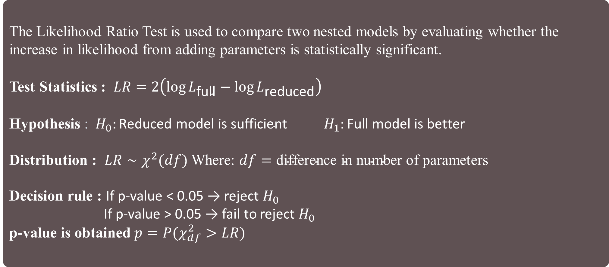
LIKELIHOOD RATIO TEST
The Likelihood Ratio Test is used to compare two nested models by evaluating whether the increase in likelihood from adding parameters is statistically significant.
Test Statistics : $LR=2\left(\log{L_{\text{full}}}−\log{L_{\text{reduced}}}\right)$
Hypothesis : ${ H}_{0}:\text{Reduced} \text{model} \text{is} \text{sufficient} H_{1}:\text{Full} \text{model} \text{is} \text{better}$
Distribution : $LR∼χ^{2}(df)$ Where: $df=\text{difference} \text{in} \text{number} \text{of} \text{parameters}$
Decision rule : If p-value < 0.05 → reject $H_{0}$
If p-value > 0.05 → fail to reject $H_{0}$
p-value is obtained $p=P(χ_{df}^{2}>LR)$

Slide 26
Result & INTERPRETATION
Comparison | LR Statistic | df Difference | p-value | Decision
Model 4 vs Model 3 | -827.54 | 4 | 1.000 | Model 3 preferred
Model 4 vs Model 2 | 1329.96 | 13 | < 0.001 | Model 4 significantly better
Model 4 vs Model 1 | 26908.38 | 20 | < 0.001 | Model 4 significantly better

Slide 27
Model 4 vs Model 1
The LR statistic is extremely large (26908.38) with 20 degrees of freedom and a p-value close to zero. This strongly suggests that Model 4 is substantially better than Model 1, indicating that the additional predictors greatly improve model performance.
Model 4 vs Model 2
The LR statistic is 1329.96 with 13 degrees of freedom, and the p-value is effectively zero. This indicates that Model 4 provides a significantly better fit than Model 2. Hence, the additional predictors included beyond Model 2 contribute meaningfully to explaining variation in pain levels
Model 4 vs Model 3
The likelihood ratio statistic is negative (−827.54), indicating that the log-likelihood of Model 4 is lower than that of Model 3. This implies that the additional predictors included in Model 4 do not improve model fit. The p-value of 1.000 confirms that there is no statistical evidence to reject the null hypothesis. Therefore, Model 3 is preferred over Model 4, as it provides a better fit with fewer parameters.
Final Conclusion
Overall, while Model 4 significantly improves upon Models 1 and 2, it does not outperform Model 3. The inclusion of additional predictors in Model 4 leads to a reduction in model fit, suggesting overfitting or inclusion of non-informative variables. Therefore, Model 3 is selected as the final model, as it achieves a better balance between goodness-of-fit and model parsimony.

Slide 28
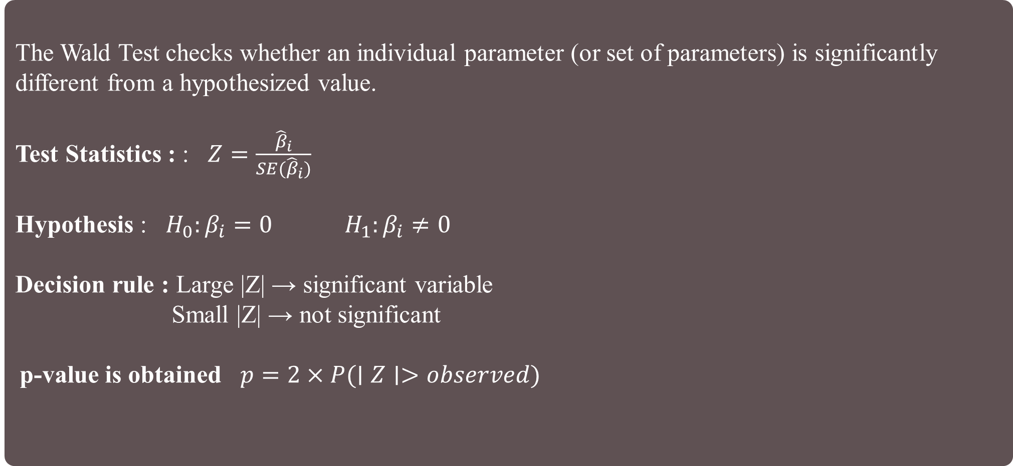
wald TEST
The Wald Test checks whether an individual parameter (or set of parameters) is significantly different from a hypothesized value.
Test Statistics : : $Z=\frac{{\hat{β}}_{i}}{SE({\hat{β}}_{i})}$
Hypothesis : $H_{0}:β_{i}=0 H_{1}:β_{i}≠0$
Decision rule : Large |Z| → significant variable
Small |Z| → not significant
p-value is obtained $p=2×P(∣Z∣>observed)$

Slide 29
Result & INTERPRETATION
Variable | Coefficient | p-value
overall_health_score | -1.914 | <0.001
stress_score_cycle | -0.372 | <0.001
concentration_score | -0.087 | <0.001
energy_level | -0.059 | <0.001
mood_score | -0.057 | <0.001
cycle_length_days | -0.008 | <0.001
sleep_hours | 0.136 | <0.001
sleep_hours_cycle | 0.202 | <0.001
work_hours_lost | 0.250 | <0.001
flow_level | 0.292 | <0.001
Intercept | 20.742 | <0.001
Group Var | 0.776 | <0.001

Slide 30
The results from the mixed-effects model indicate that several physiological, behavioral, and cycle-related variables significantly influence pain levels. Among these, overall health score exhibits the strongest negative association, suggesting that individuals with better overall health tend to report substantially lower pain levels.
Psychological factors such as stress score (cycle-specific), mood score, energy level, and concentration score are also highly significant, indicating that mental and emotional well-being plays a crucial role in determining pain experience.
Cycle-related variables such as flow level and work hours lost show strong positive associations with pain, implying that higher menstrual flow and functional impairment are linked with increased pain levels. Additionally, sleep-related variables (both general and cycle-specific) show significant positive effects, suggesting a complex relationship between sleep and pain.
The random effect variance (Group Var) is statistically significant, confirming substantial variability in baseline pain levels across individuals, thereby justifying the use of a mixed-effects modeling approach.

Slide 31
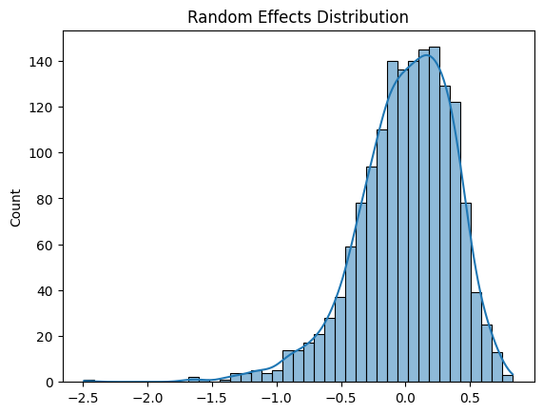
RANDOM EFFECT DISTRIBUTION
Random effects capture individual-level deviations .
The bars and the smooth density curve indicate that the distribution is right-skewed. Most individuals have random effects close to zero, meaning their pain levels align fairly well with the overall average once predictors are considered.
There’s a tail stretching toward -2.5,The skew toward negative values suggests that many individuals consistently report lower-than-average pain levels, while only a few report higher-than-average pain.

Slide 32
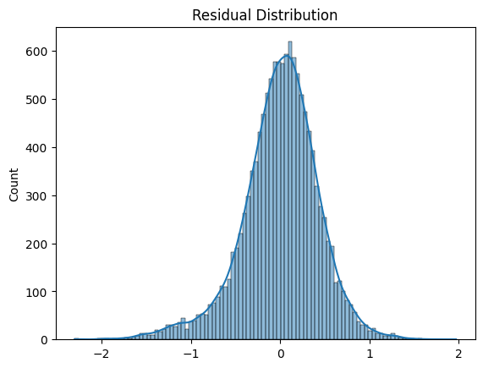
RESIDUAL DISTRIBUTION
Residuals are approximately normally distributed but show slight skewness and deviation from perfect normality.
In real life residuals are not perfectly follows normal distribution and the reasons are Human behavior variability,
Missing variables.
Most residuals cluster near 0, meaning the model’s predictions are generally accurate . The distribution looks fairly symmetric, suggesting that errors are balanced. Some individuals have slightly higher pain than predicted, others slightly lower, but there’s no strong bias in one direction.

Slide 33
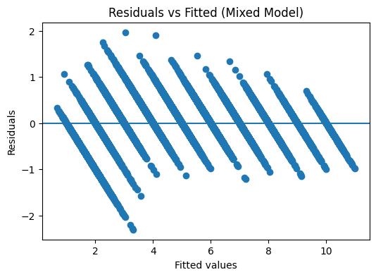
RESIDUAL vs FITTED
Residuals are distributed fairly evenly above and below the zero line, which means the model isn’t systematically over- or under-predicting pain at different fitted values.
The bands suggest that fitted values take on certain discrete levels — likely because pain scores are measured on a limited scale. That's normal in health data.
In plot, the spread looks fairly consistent across fitted values, which suggests no major heteroscedasticity (variance changing with predicted pain). It means the model’s error is stable across pain levels.
.

Slide 34
K-FOLD CROSS VALIDATION
K-Fold Cross-Validation (often called “K-Fold test”) is a resampling technique used to evaluate how well a model will perform on unseen data.
In K-Fold Cross-Validation:
1. The dataset is divided into K equal (or nearly equal) parts called folds
2. The model is trained K times
3. Each time:
a) Use K−1 folds for training
b) Use the remaining 1-fold for testing
c) Rotate the test fold each time so every fold is used once as a test set
Final performance = average of all K results
Assumptions of K-Fold Cross-Validation
Independent and Identically Distributed (i.i.d.) Data
2. No Data Leakage
3. Representative Folds
4. Sufficient Data Size
5. Stationarity (for general ML settings)

Slide 35

LASSO REGRESSION
Lasso Regression (Least Absolute Shrinkage and Selection Operator) is a type of linear regression
that adds a penalty to the model to both shrink coefficients and perform variable selection.
Objective Function =$\min{(\sum_{i=1}^{n}{(}\left.y_{i}−{\hat{y}}_{i}{\left.)\right.}^{2}+λ\sum_{j=1}^{p}{∣}β_{j}∣\right)}$
ASSUMPTIONS:
1. Linearity : The relationship between predictors and response is linear
2. Independence of Errors : Residuals are independent (no autocorrelation)
3. Homoscedasticity : Constant variance of errors across all levels of predictors
4. Normality of Errors (optional but useful) : Errors are normally distributed (important for inference,
less for prediction)
5. No Perfect Multicollinearity : Predictors should not be perfectly correlated. Lasso can handle
multicollinearity better than OLS, but it tends to pick one variable and ignore others in highly correlated groups
6. Feature Scaling is important variables should be standardized (mean = 0, variance = 1). Otherwise,
penalty is applied unevenly.

Slide 36
Feature Selection & Insights from Lasso
Core Idea: Automatic Feature Selection: -
Lasso uses L1 regularization to shrink coefficients
Some coefficients become exactly zero
This means those features are automatically removed from the model
Why Feature Selection Matters: -
Reduces overfitting
Improves model interpretability
Removes noise & irrelevant variables
Creates a simpler, more generalizable model
progesterone_ngml
log_consistency_score
water_intake_liters
alcohol_consumption
These features do not contribute to prediction → model simplifies itself.
Strong Positive Impact: | Strong Negative Impact:
work_hours_lost (+0.49) sleep_hours (+0.22) flow_level (+0.28) progesterone_ngml Log_consistency_score water_intake_liters alcohol_consumption | overall_health_score (−1.69) stress_score_cycle (−0.52) bmi (−0.12)

Slide 37
Lasso Regression with K-Fold Cross Validation
Alpha | CV R² | CV Std | Train R² | Train Adj R² | Test R² | Test Adj R²
0.0001 | 0.9369 | 0.0034 | 0.9374 | 0.9372 | 0.9361 | 0.9356
0.001 | 0.9369 | 0.0033 | 0.9374 | 0.9372 | 0.9361 | 0.9356
0.01 | 0.9365 | 0.0034 | 0.9368 | 0.9366 | 0.9358 | 0.9353
0.1 | 0.9163 | 0.0047 | 0.9165 | 0.9162 | 0.9167 | 0.9161
0.2 | 0.8971 | 0.0048 | 0.8974 | 0.8970 | 0.8979 | 0.8971
0.3 | 0.8750 | 0.0049 | 0.8753 | 0.8749 | 0.8756 | 0.8746
0.5 | 0.8254 | 0.0052 | 0.8256 | 0.8251 | 0.8252 | 0.8239
1.0 | 0.6490 | 0.0055 | 0.6494 | 0.6482 | 0.6476 | 0.6449
5.0 | -0.0010 | 0.0011 | 0.0000 | -0.0032 | -0.0004 | -0.0080
10.0 | -0.0010 | 0.0011 | 0.0000 | -0.0032 | -0.0004 | -0.0080

Slide 38
INTERPRETATION
Progesterone (progesterone_ngml) → Removed Progesterone was excluded because its effect overlaps with estrogen (estrogen_pgml), a biologically related hormone that was retained in the model. Since estrogen already has a measurable influence (coefficient = −0.001788), Lasso selected it as the stronger representative and removed progesterone due to redundancy.
Log Consistency Score (log_consistency_score) → Removed The information captured by this variable is largely reflected in overall_health_score (coefficient = −1.698467), which shows a much stronger effect. Additionally, factors like prepared_before_period may already incorporate aspects of consistency. Lasso prioritizes the most influential predictor, leading to the removal of log consistency score.
Water Intake (water_intake_liters) → Removed Water intake acts as a general lifestyle indicator, but its effect overlaps with broader variables such as diet_quality, sleep_hours, and overall_health_score. Since these variables collectively capture lifestyle more comprehensively, Lasso determined that water intake does not provide additional unique information.
Alcohol Consumption (alcohol_consumption) → Removed Alcohol consumption is often correlated with other lifestyle factors such as smoking_status, diet, sleep, and stress levels. Instead of retaining multiple correlated variables, Lasso captures the combined lifestyle effect through stronger predictors and removes alcohol consumption due to its limited independent contribution.

Slide 39
conclusion
Comprehensive modeling identifies menstrual pain as a complex interplay of biological, psychological, and lifestyle factors.
Overall health score stands as the most significant predictor, where higher health levels directly correlate with lower pain.
Psychological factors like stress, mood, and energy levels are deeply linked to the physical intensity of pain.
Increased menstrual flow and cycle-related functional impairment are primary drivers of higher pain scores.
LASSO regression successfully refined the model by removing redundant lifestyle variables like water intake and alcohol consumption.
Mixed-effects modeling highlights significant individual variation, necessitating personalized approaches to menstrual health.
The final model achieves high accuracy, explaining approximately 92.6% of the variance in reported pain levels.
Results advocate for a holistic healthcare strategy that integrates mental well-being and lifestyle habits with biological care.

